Slide 1
Other Balanced Trees, and an Unbalanced One (Huffman Encoding)
EECS 233

Slide 2
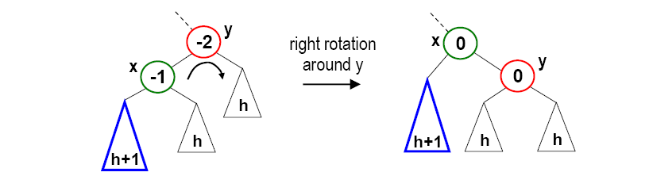
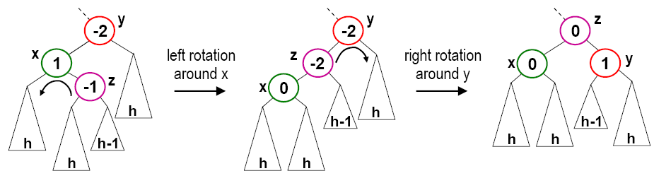
Previous Lecture
AVL trees (self-balancing binary tree)
Rotation operations: left rotation, right rotation, double rotation
h+1

Slide 3
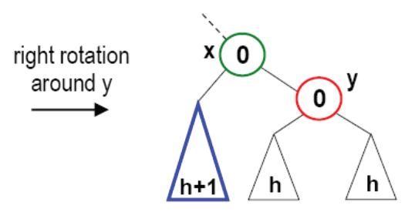
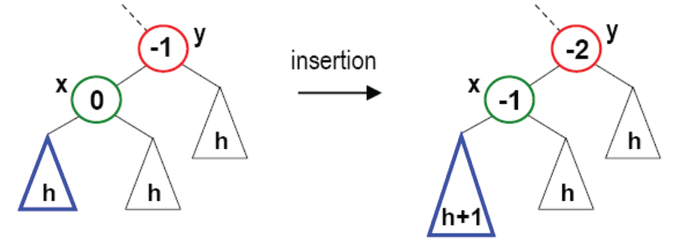
Previous Lecture: AVL Trees
AVL trees (self-balancing binary tree)
Insertion algorithm
  Insert a node, which may cause a change to balance values
  For each ancestor (from the leaf to the root), if the balance value
    changes from +/-1 to 0, DONE
    changes from 0 to +/- 1, go to the next ancestor
    changes from +/-1 to +/- 2, rebalance this tree, DONE
  How to balance the tree? If insertion occurred in the
    left-left subtree, do right rotation
    right-right subtree, do left rotation
    left-right subtree, do left-right double rotation
    right-left subtree, do right-left double rotation
insertion
h+1

Slide 4
AVL Trees -- Deletion
Deletion is more complicated.
  It requires both single and double rotations
  We may need more than one rebalance operation (rotation) on the path from the deleted node back to the root.
Steps:
  First delete the node the same as deleting it from a binary search tree
    Remember that a node can be either a leaf node or a node with a single child or a node with two children
  Walk through from the deleted node back to the root and rebalance the nodes on the path if required
    Since a rotation can change the height of the original tree
Deletion is O(logN)
  Each rotation takes O(1) time
  We may have at most h (height) rotations, where h = O(logN)

Slide 5
AVL Trees -- Deletion
For the implementation
  We have a shorter flag that shows if a subtree has been shortened
  Each node is associated with a balance factor
    left-high the height of the left subtree is higher than that of the right subtree
    right-high the height of the right subtree is higher than that of the left subtree
    equal the height of the left and right subtrees is equal
In the deletion algorithm
  Shorter is initialized as true
  Starting from the deleted node back to the root, take an action depending on
    The value of shorter
    The balance factor of the current node
    Sometimes the balance factor of a child of the current node
  Until shorter becomes false

Slide 6
AVL Trees -- Deletion
Three cases according to the balance factor of the current node
The balance factor is equal
➔ no rotation
The balance factor is not equal and the taller subtree was shortened
➔ no rotation
The balance factor is not equal and the shorter subtree was shortened
➔ rotation is necessary

Slide 7
AVL Trees -- Deletion
Case 1: The balance factor of p is equal.
  Change the balance factor of p to right-high (or left-high)
  Shorter becomes false
–
p
\
p
No rotations
Height unchanged
T₁
T₂
T₁
T₂
deleted

Slide 8
AVL Trees -- Deletion
Case 2: The balance factor of p is not equal and the taller subtree is shortened.
  Change the balance factor of p to equal
  Shorter remains true
/
p
–
p
No rotations
Height reduced
T₁
T₂
T₁
T₂
deleted

Slide 9
AVL Trees -- Deletion
Case 3: The balance factor of p is not equal and the shorter subtree is shortened.
  Rotation is necessary
  Let q be the root of the taller subtree of p
  We have three sub-cases according to the balance factor of q

Slide 10
AVL Trees -- Deletion
Case 3a: The balance factor of q is equal.
  Apply a single rotation
  Change the balance factor of q to left-high (or right-high)
  Shorter becomes false
p
/
q
\
–
q
p
\
h-1
T₁
h
T₃
h
T₂
h
T₃
deleted
h-1
T₁
T₂
h
Single rotation
Height unchanged

Slide 11
AVL Trees -- Deletion
Case 3b: The balance factor of q is the same as that of p.
  Apply a single rotation
  Change the balance factors of p and q to equal
  Shorter remains true
p
–
q
\
\
q
–
p
h-1
T₁
h
T₃
h-1
h-1
T₂
T₃
h-1
T₁
T₂
h
deleted
Single rotation
Height reduced

Slide 12
AVL Trees -- Deletion
Case 3c: The balance factor of q is the opposite of that of p.
  Apply a double rotation
  Change the balance factor of the new root to equal
  Also change the balance factors of p and q
  Shorter remains true
p
–
r
\
h-1
/
q
p
q
r
T₁
T₄
h-1
h-1 or
h-2
T₄
h-1
T₂
T₃
deleted
T₁
h-1
h-1 or
h-2
T₂
T₃
Double rotation
Height reduced

Slide 13
AVL Trees -- Deletion
Exercise: Delete o from the following AVL tree
m
p
e
c
j
n
s
d
h
k
r
u
b
o
a
g
i
l
t
f

Slide 14
Efficiency of AVL Trees
An AVL tree containing n items has a height that is O(log₂n).
Search and insertion are both O(log₂n).
  Search travels at most one path down the tree
  An insertion goes down one path to the insertion point, and then goes back up adjusting balances/performing rotations
    in the worst case, both the path down and the path back up consider O(log₂n) nodes
    each rotation requires a constant number of operations, and we perform at most two of them for a given insertion
Deletion begins with the same procedure used in binary search trees (O(log₂n) complexity). It can also require rotations to rebalance the tree, also at the complexity of O(log₂n).

Slide 15
Other Trees
2-3 trees
Splay trees
Red-black trees
B-trees

Slide 16
Aren’t AVL Trees Perfect?
AVL tree - binary balanced tree
  Searching an item requires traversing from root to (at most) leaf
  logN descents (random accesses)
  Visiting each node - one comparison.
On disk:
  Random access is expensive
  Disk read is in blocks (e.g. 4K bytes at once)
  Disk-based AVL trees waste much of a block for an internal node read
    The node is smaller than the block
    Payload of the node is not used
33
12
5
3
8
1
4
6
9

Slide 17
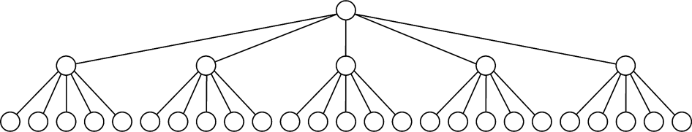
Designing for Disk Particulars
33
12
5
17
3
8
14
25
1
4
6
9
13
15
23
29
<7
[40-48)
[7-15)
[15-30)
[30-40)
1
3
4
5
6
8
9
12
13
14
15
17
23
25
29
33

Slide 18
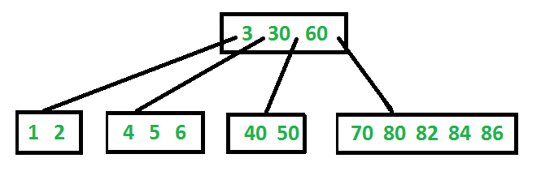
B-Tree
Reduce the number of disk accesses
All leaves are at same level
Defined by its minimum degree ‘t’
Every node except root must contain at least t-1 keys
  Root may contain minimum 1 key
All nodes (including root) may contain at most 2t – 1 keys
Number of children of a node is equal to the number of keys in it plus 1

Slide 19
B-Tree – Alternative Definition
B-Trees are specialized M-ary search trees
Each node has many keys
maximum branching factor of M
the root has between 2 and M children or at most L keys
other internal nodes have between ⎡M/2⎤ and M children
internal nodes contain only search keys (no data)
each (non-root) leaf contains between ⎡L/2⎤ and L keys
all leaves are at the same depth

Slide 20
B-Tree Example
B-Tree with M = 4
and L = 4
10
40
3
15
20
30
50
1
2
10
11
12
20
25
26
40
42
3
5
6
9
15
17
30
32
33
36
50
60
70

